Slide 1
Energy to GDP per Capita Comparison
Lawrence Haggerty

Slide 2
Agenda
Introduction
Description / Definitions
Initial Comparison
Investigating Change
Technology / Future Growth
Summary

Slide 3
Introduction
There has been a consistent axiom since the beginning of the industrial revolution that energy drives commerce.
This project compares how the production and consumption of energy compares to the gross domestic product (GDP) per capita at the state and national level focused on understanding the trajectory for movement away from fossil fuel as our primary energy source and its alignment to the nation’s leading fiscal metric.
Analysis utilized energy & economic related data sets from the Bureau of Economic Analysis, US Census Bureau, Energy Information Agency, & International Information Agency.
Years Reviewed: 1970, 1980, 1990, 2000, 2010, 2020

Slide 4
Description / Definitions
Description
Definitions
Analysis utilized energy & economic related data sets from the Bureau of Economic Analysis, US Census Bureau, Energy Information Agency, & International Information Agency.
Years Reviewed: 1970, 1980, 1990, 2000, 2010, 2020
GDP: The total monetary value, or market value, of finished goods and services produced within a country during a period.
GDP per capita: Economic metric that breaks down a country's economic output per person.
Fossil Fuels: Includes Coal, Crude Oil, & Natural Gas
Nuclear: Nuclear electric power production in Btu, which also equals consumption, is the nuclear electricity net generation multiplied by the average heat rate of the nuclear power plants.
Renewables: Includes Biofuels, Geothermal, Hydroelectric, Solar, Wind,Wood, & Biomass Waste
Notes:
GDP: https://online.hbs.edu/blog/post/why-is-gdp-important
GDP per Capita: https://www.investopedia.com/terms/p/per-capita-gdp.asp#:~:text=GDP%20per%20capita%20measures%20the,per%20person%20in%20a%20nation.

Slide 5
Initial Comparison
Consumption / Production / GDP per Capita

Slide 6
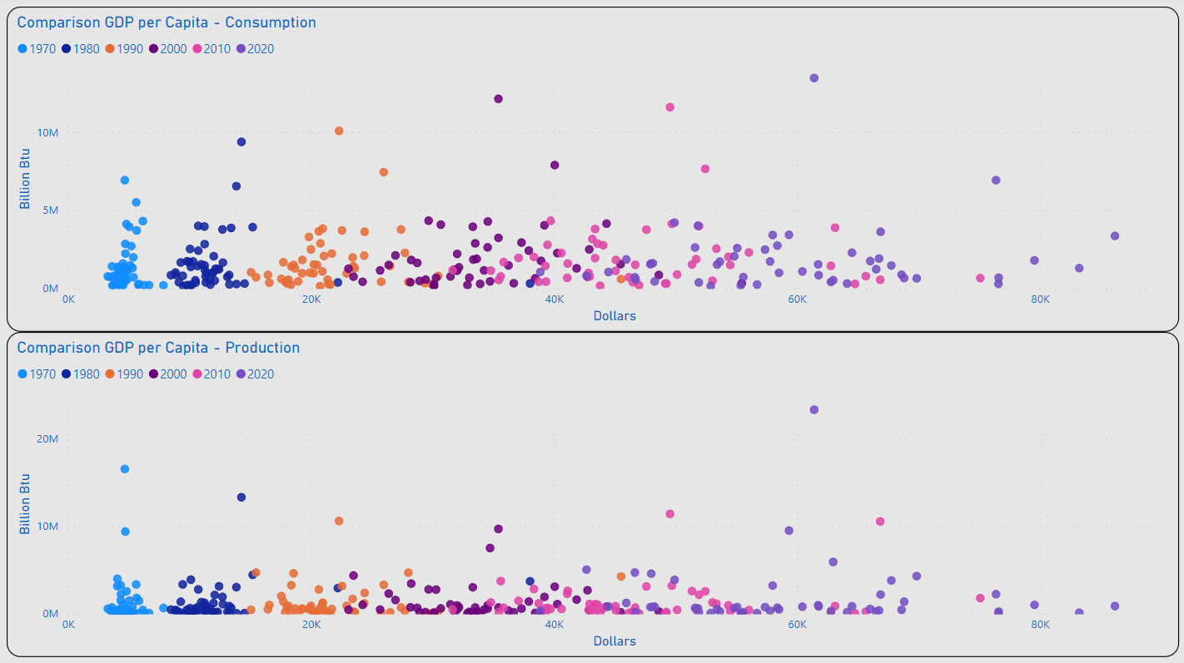
Consumption / Production
TX
Most States Remained Under 5M (BN Btu) for Consumption and Production
The Range of Values for GDP per Capita Appeared to Begin a Wider Dispersion in 2000
2020 Outliers for Consumption: TX & CA
2020 Outlier for Production: TX
Outliers for GDP per Capita Included: MA, NY & WA
CA
NY
WA
MA
TX
WA
MA
NY

Slide 7
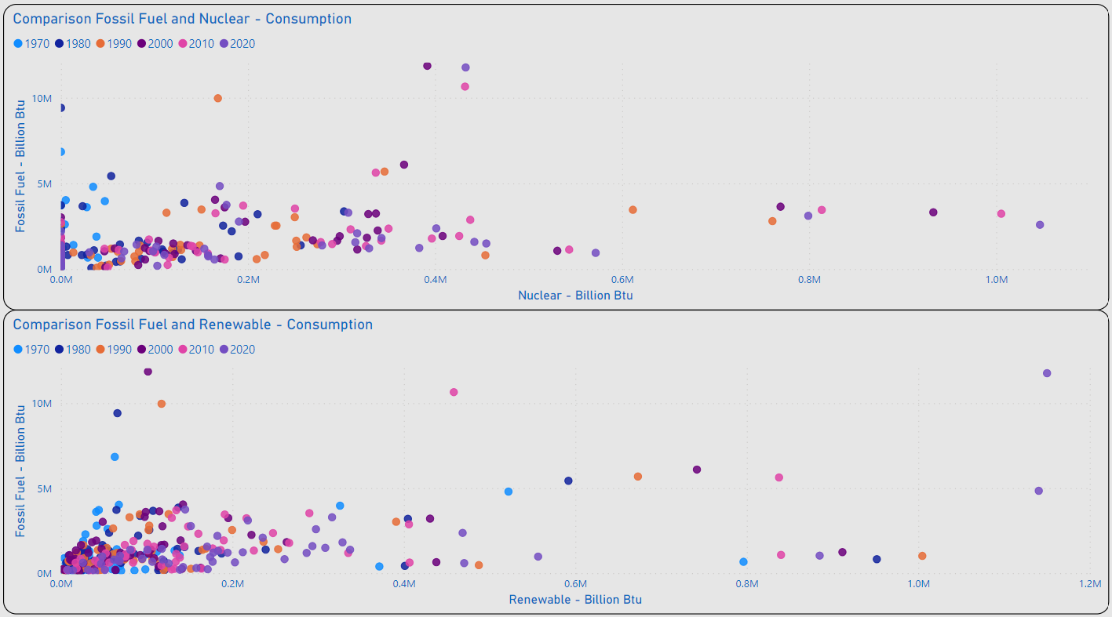
Energy Mix - Fossil Fuel to Alternatives
IL, PA, SC Lead the US in Consumption of Nuclear Energy
As of 2020 Several States Have Not Integrated the Use of Nuclear Energy: IN, MT, OK, SD, WY & VT
As of 2020 TX, CA, & WA Lead the US in Consumption of Renewable Energy
Distribution of Values for the Majority of States Remains < 200K (BN Btu) for Renewable Consumption
PA
IL
SC
TX
CA
WA

Slide 8
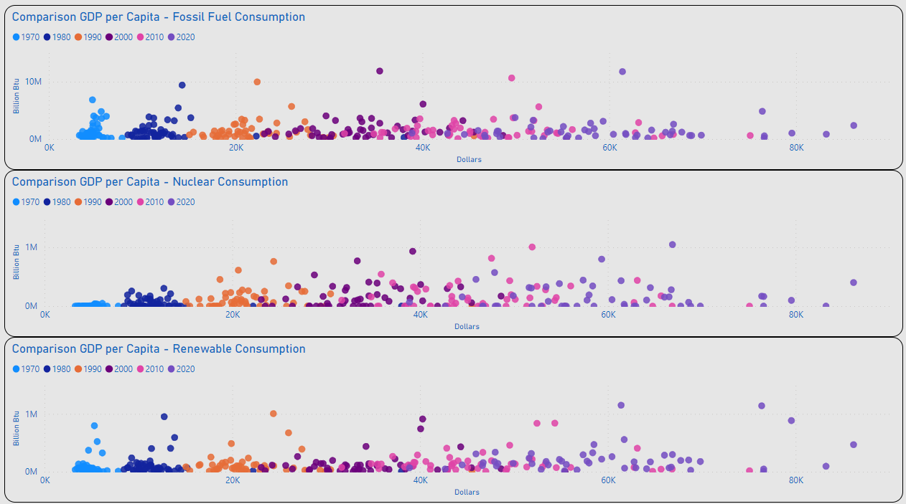
GDP per Capita – Energy Mix
Review of Distribution for Individual Energy Types Remains Generally Consistent with Initial Consolidated View for Consumption / GDP per Capita

Slide 9
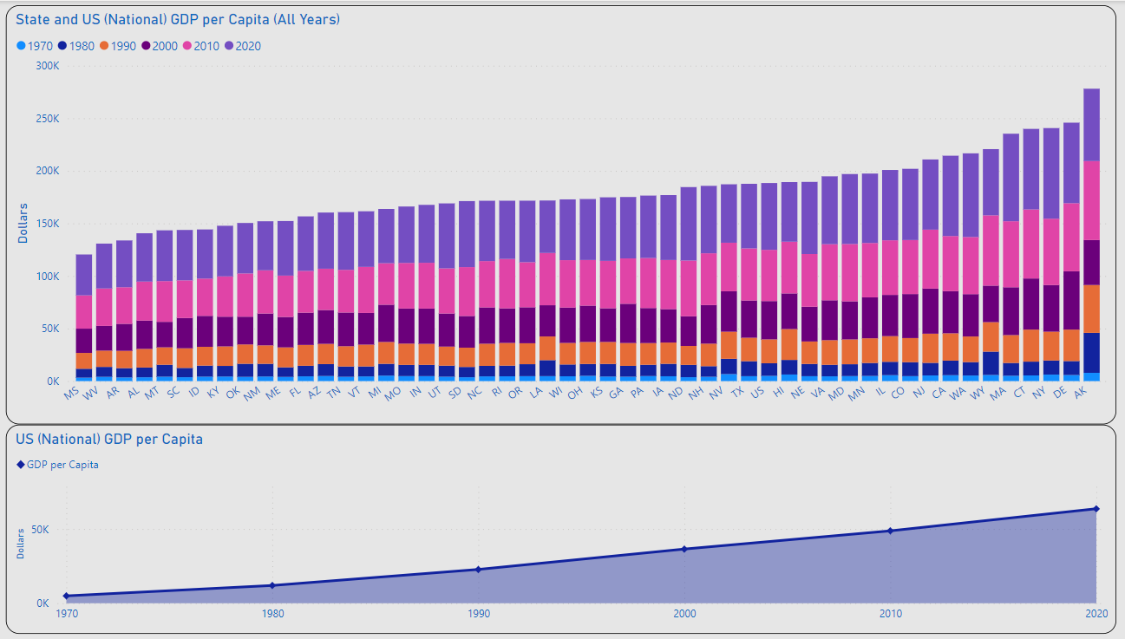
GDP per Capita
MAX: $86.2K
US AVG
US GDP per Capita Ranged from $5K in 1970 to $63.5K in 2020
MAX GDP per Capita: 2020 NY $86.2K
MIN GDP per Capita: 1970 MS $3.3K
Overall Increase Expected to Continue
MIN: $3.3K
US GDP per Capita: $63.5K
US GDP per Capita: 5K

Slide 10
Investigating Change
Consumption / Production / GDP per Capita

Slide 11
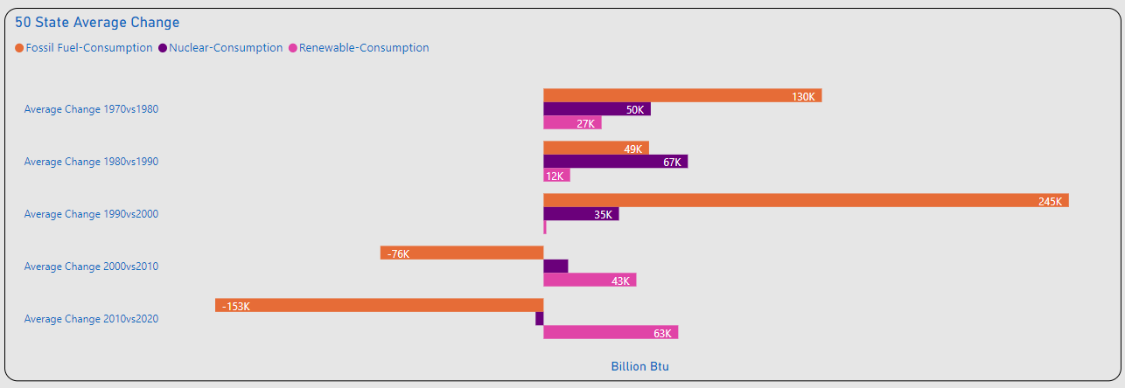
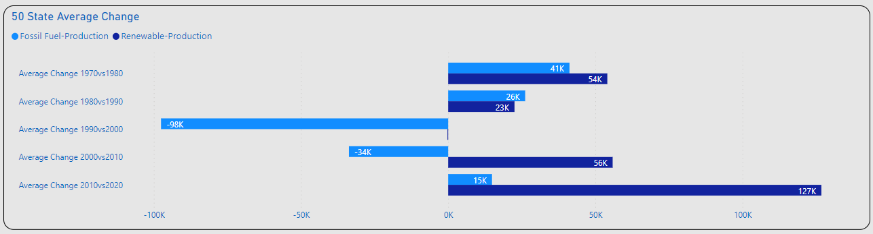
Amount of Change
Significant Changes Consumption
1980vs1990: Nuclear(+)
1990vs2000: Fossil Fuel(+)
2010vs2020: Fossil Fuel(-)
2010vs2020: Renewables(+)
Significant Changes Production
1990vs2000: Fossil Fuel(-)
2010vs2020: Renewable(+)

Slide 12
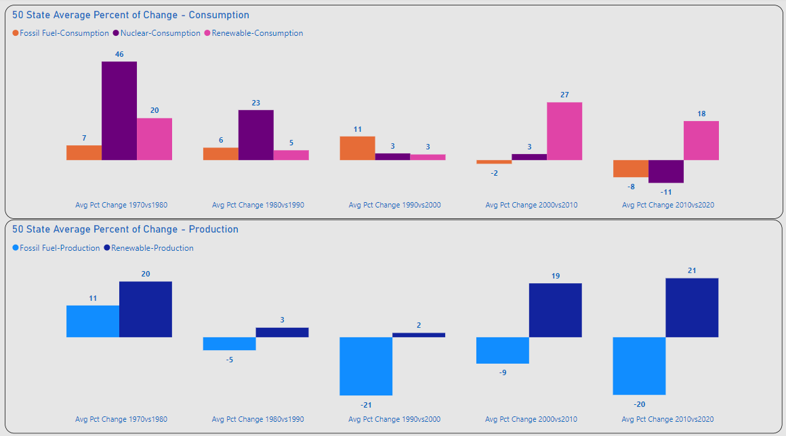
Percent of Change
Consumption
1970vs1980: Nuclear(+)
2000vs2010: Renewable(+)
2010vs2020: Fossil Fuel / Nuclear (-), Renewables(+)
Production
Overall Fossil Fuel(-)
Overall Renewable(+)

Slide 13
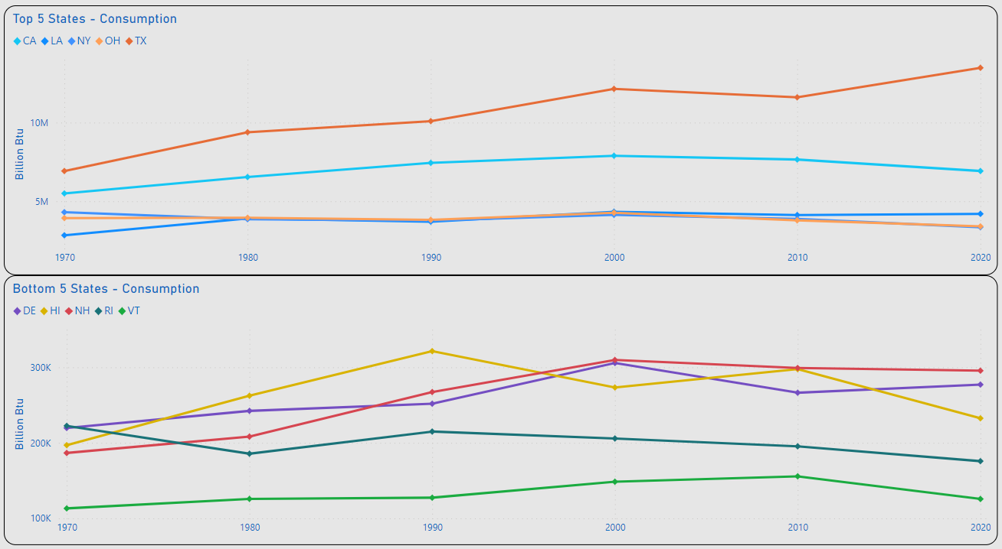
Top 5 / Bottom 5 – Change Consumption
TX: 13.5M
Top 5 Consumption
MAX: TX 6.9M – 13.5M(BN Btu)
Highest Decrease: NY 4.3M – 3.4M (BN Btu)
NY & OH (-) Overall Consumption
Bottom 5 Consumption
MIN: VT 113K – 125K (BN Btu)
RI (-) Overall Consumption
TX: 6.9M
NY: 4.3M
NY: 3.4M
RI: 225K
RI: 176K
VT: 113K
VT: 125K

Slide 14
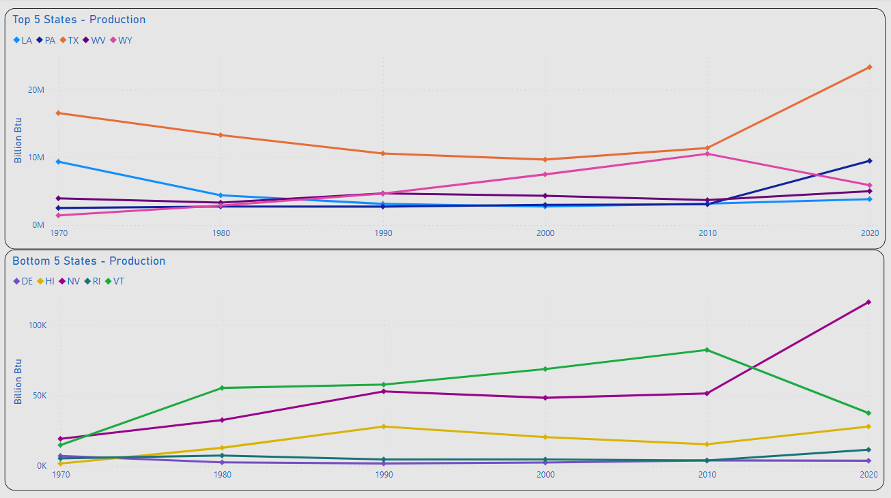
Top 5 / Bottom 5 – Change Production
TX: 23.3M
TX: 16.5M
Top 5 Production
MAX: TX 16.5M – 23.3M(BN Btu)
Highest Decrease: LA 9.4M – 3.8M (BN Btu)
TX, PA, WV, WY(+) Overall Production
Bottom 5 Production
MIN: DE 7K – 3.5K (BN Btu)
HI, NV, RI, VT (+) Overall Production
LA: 9.4M
LA: 3.8M
DE: 7K
DE: 3.5K

Slide 15
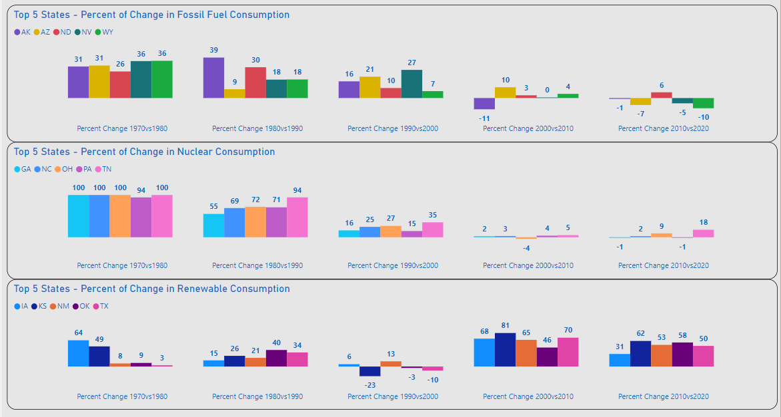
Top 5 Energy Mix - Consumption
Top 5 Energy Mix
Fossil Fuel and Nuclear Displays Highest Volumes of Increases 1970-2000
Renewable Consumption Displays Significant Increases After 2000

Slide 16
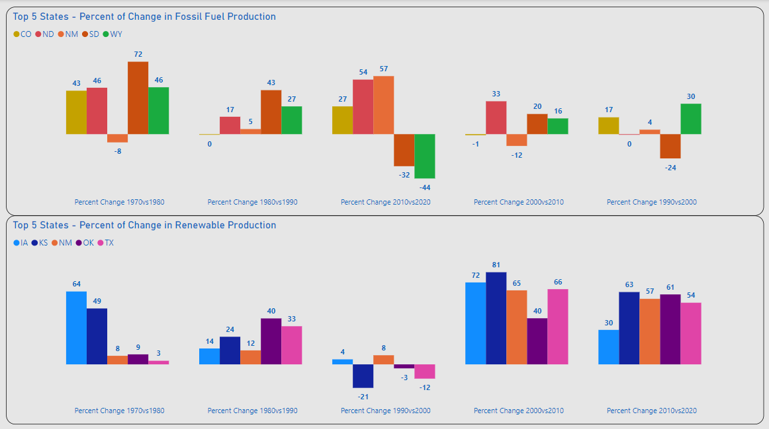
Top 5 Energy Mix - Production
Top 5 Energy Mix
Weakening of Fossil Fuel Production After 2000
Renewable Production Displays Significant Increases After 2000

Slide 17
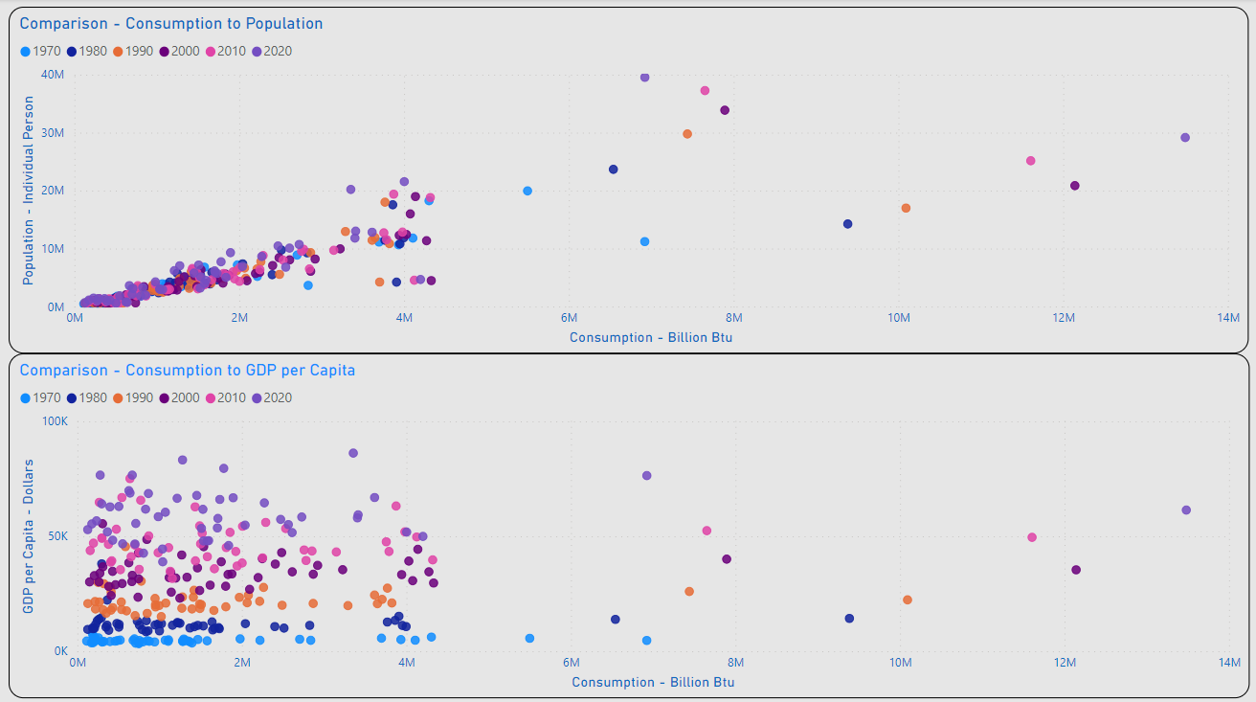
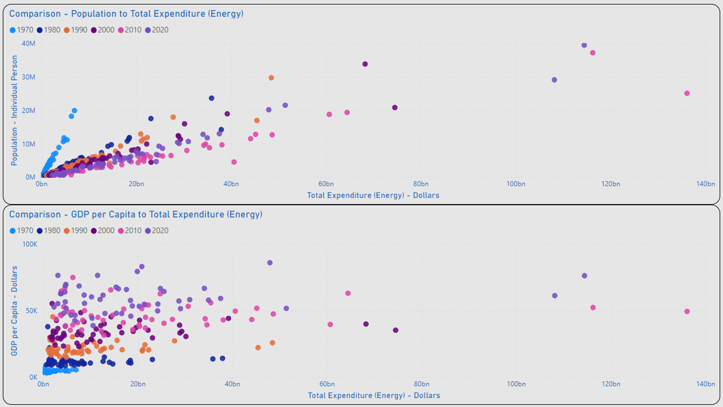
Occam’s Razor
Alignment of Population and Consumption Values Indicates a Strong Correlation
Dispersion of GDP per Capita and Consumption Values Between GDP Indicates Lack of Correlation
Occam’s Razor: The Simplest Explanation is Usually the Best One.

Slide 18
Technology / Future Growth
Consumption / Production / GDP per Capita

Slide 19
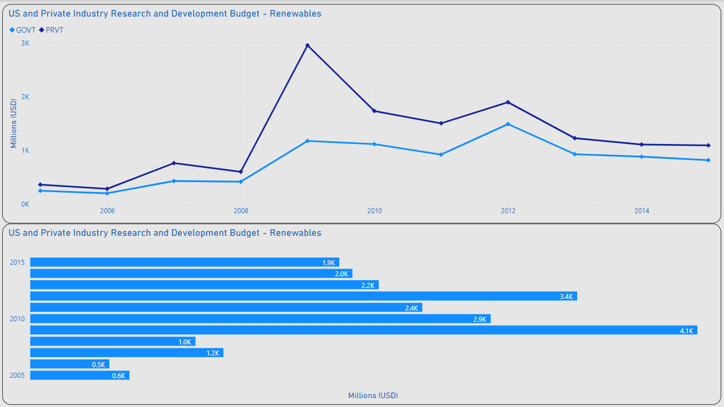
Advancing Renewable Tech
MAX PVT: 3B
R&D Investment
MAX Private Industry: 3B / 2009
MEDIAN Private Industry: 1.2B
MAX US Government: 1.9B / 2012
Median US Government: 786M
~15B Invested in R&D 2005-2015
MAX GOVT:
1.9B

Slide 20
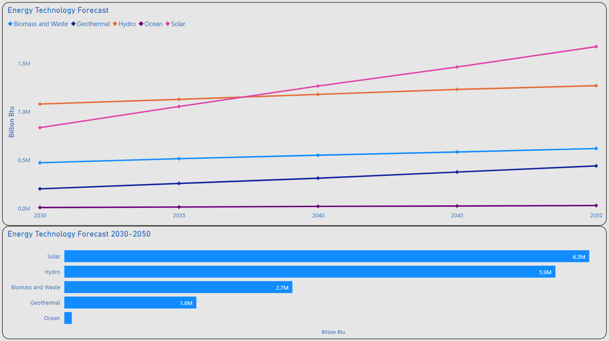
Advancing Renewable Tech
MAX Solar: 1.7M
Tech Projections
Solar Appears to be the Clear Leader in Renewable Advances / New Adoption
Solar MAX: 1.7M (BN Btu) / 2050
Solar MIN: 835K (BN Btu) / 2030
~16.6M (BN Btu) in Renewables Forecasted Between 2030 & 2050
MIN Solar: 835K

Slide 21
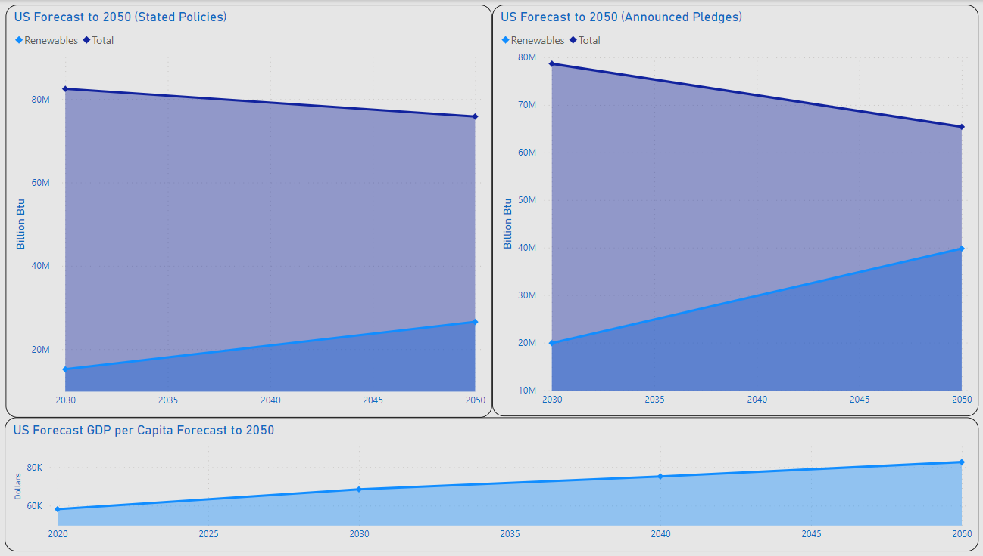
2050....Heading In The Right Direction
Total: 75.8M
Total: 65.4M
Stated Policies:
35% of US Energy Projected for Renewables
74% Increase from 2030
Announced Pledges:
60.9% of US Energy of US Energy Projected for Renewables
100% Increase from 2030
GDP per Capita:
83K
30.7% Increase from 2020
Renewables: 39.8M
Renewables: 26.5M
GDP per Capita: 83K

Slide 22
Summary
Population has the Greater Impact on Consumption vs. GDP per Capita (Occam’s Razor)
Fossil Fuel Expected to Continue Declining
Continued Usage Expected
Renewables Expected to Continue Increasing
Technological Innovation / Availability
Government Policy / Regulation

Slide 23
Thank you
Lawrence Haggerty​
lawrence.c.Haggerty@gmail.com
https://www.linkedin.com/in/lawrence-haggerty/
https://github.com/lawrence-haggerty

Slide 24
Closing Notes
Technology:
Excel: Extract Transform Load, Minor Analysis
PostgreSQL / pgAdmin: Analysis, Prepare Data for Visualization
Microsoft Power BI: Analysis, Visualization
Data Sources:
Energy Information Administration (EIA):
State Energy Data System 1960-2020: https://www.eia.gov/state/seds/seds-data-complete.php?sid=ND#StatisticsIndicators
Bureau of Economic Analysis (BEA):
Regional Data Tools: https://apps.bea.gov/regional/
United States Census Bureau:
Historical Population Change Data (1910-2020): https://www.census.gov/data/tables/time-series/dec/popchange-data-text.html
International Energy Agency (IEA):
Energy Technology RD&D Budgets: https://www.iea.org/data-and-statistics/data-product/energy-technology-rd-and-d-budget-database-2#
World Energy Investment 2023 Datafile: https://www.iea.org/data-and-statistics/data-product/world-energy-investment-2023-datafile-2

Slide 25
XXXX
XXXX
XXXX
XXXX
XXXX
XXXX
XXXX
XXXX
XXXX
XXXX
XXXX
XXXX
XXXX

Slide 26
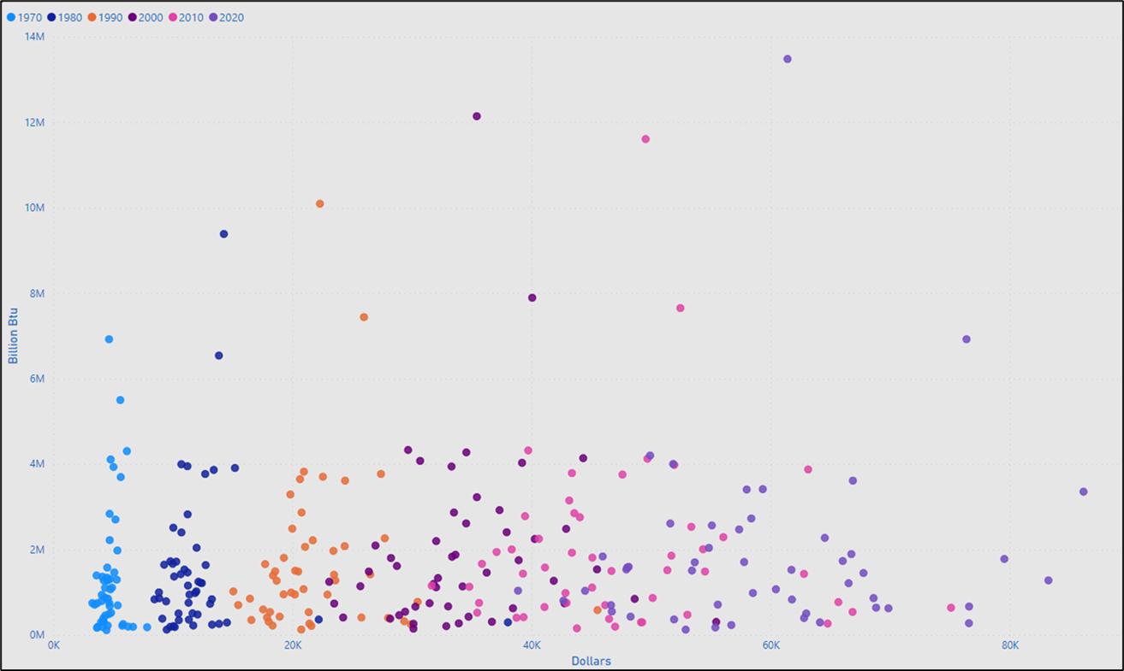
GDP per Capita - Consumption
XXXX
XXXX
XXXXXXXXXX

Slide 27
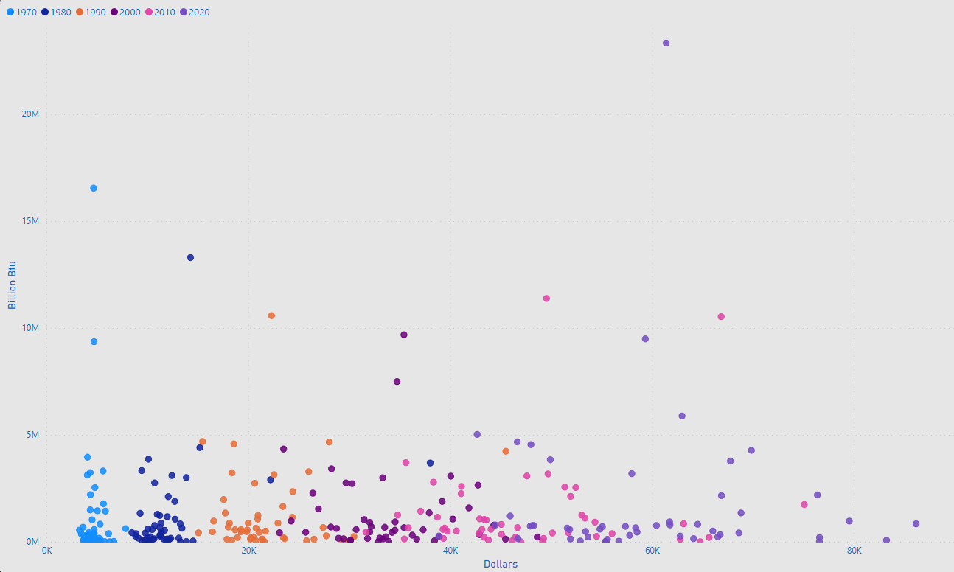
Comparison GDP per Capita - Production
XXXX
XXXX
XXXXXXXXXX

Slide 28
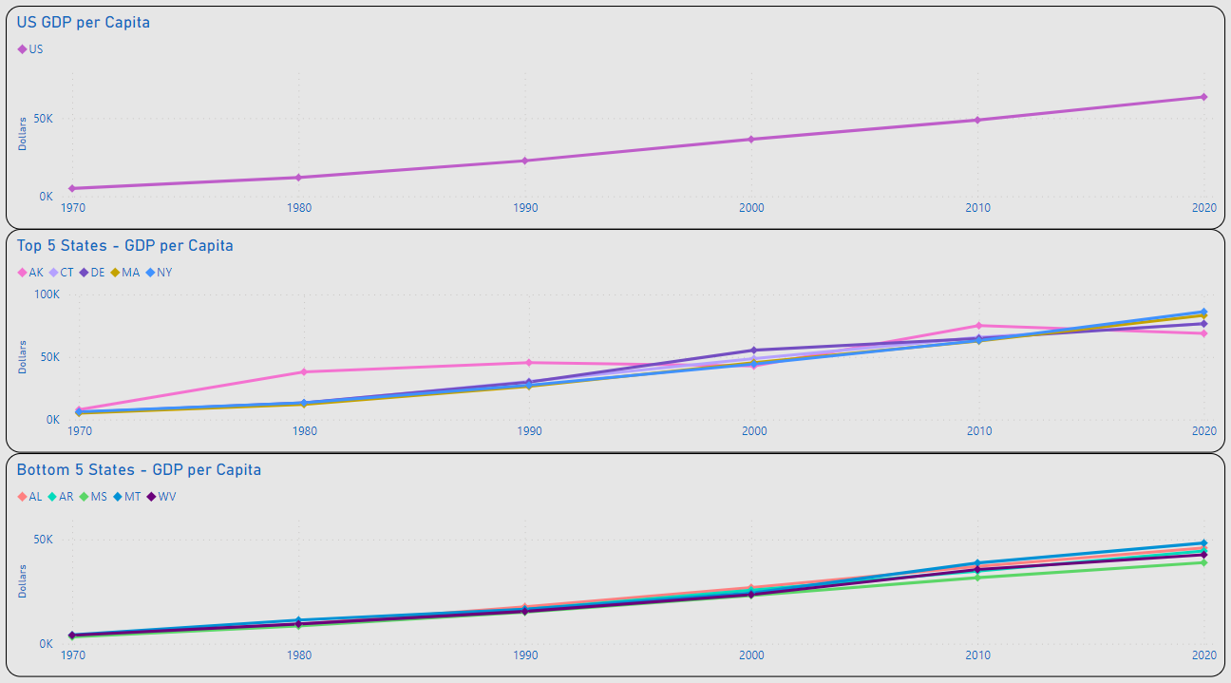
XXXX
US GDP per Capita Ranged from $5K in 1970 to $63.5K in 2020
MAX Top 5 GDP per Capita: 2020 NY $86.2K
MIN Top 5 GDP per Capita: 1970 CT $5.4K
MAX Bottom 5 GDP per Capita: 2020 AL $46K
MIN Bottom 5 GDP per Capita: 1970 MS $3.3K
CHOOSE 1 GDP PER CAPITA SLIDE

Slide 29
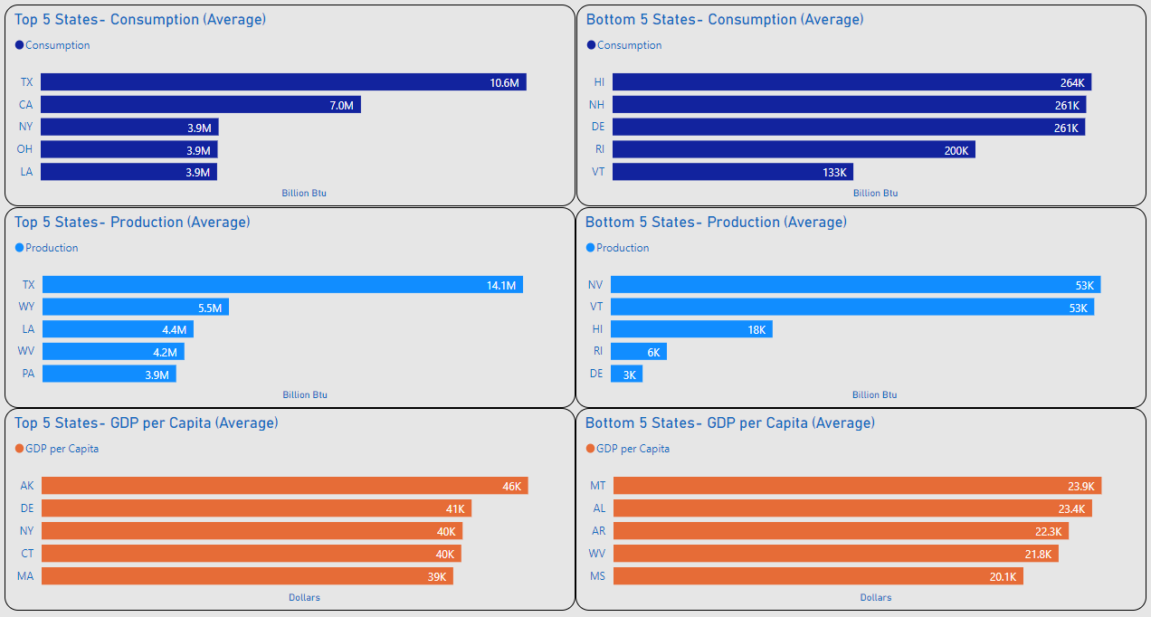
Top 5 / Bottom 5
XXXX
XXXX

Slide 30
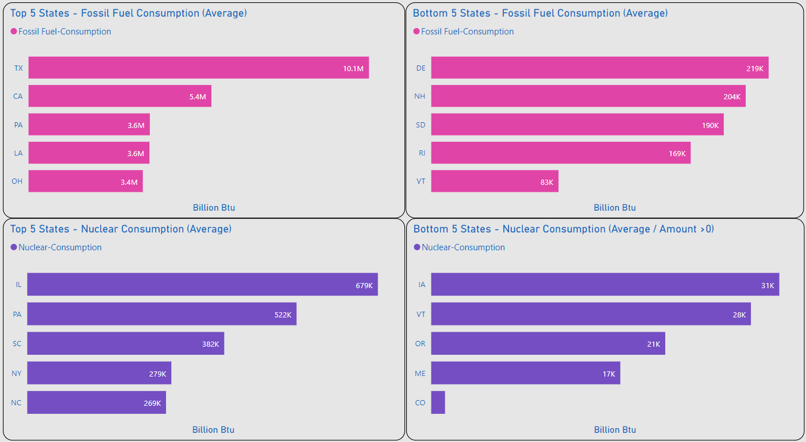
Top 5 / Bottom 5
XXXX
XXXX

Slide 31
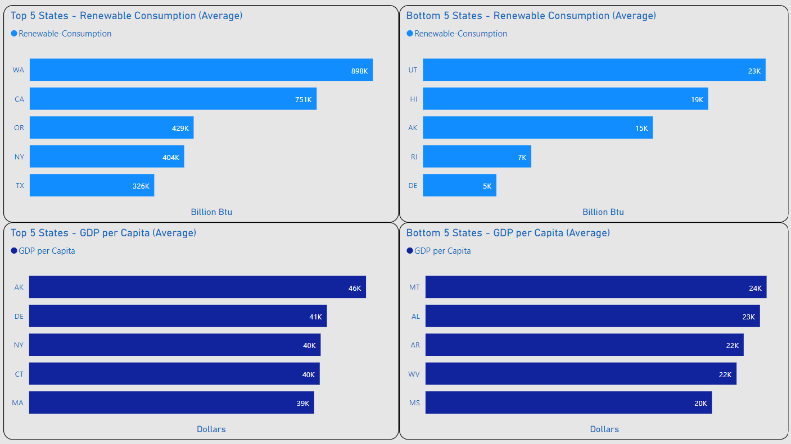
Top 5 / Bottom 5
XXXX
XXXX

Slide 32
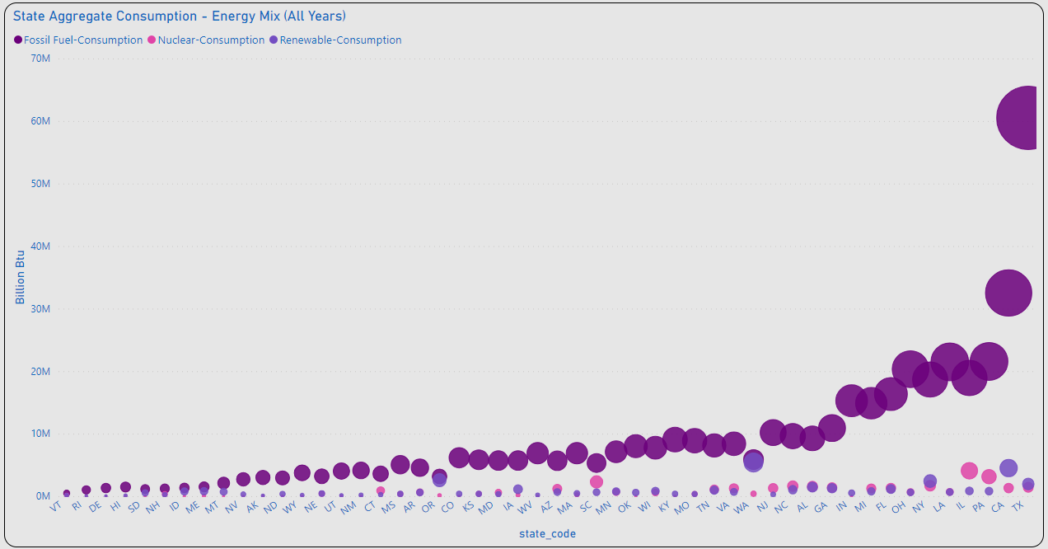
Energy Mix – Aggregate Consumption
XXXX
XXXX
XXXXXXXXXX

Slide 33
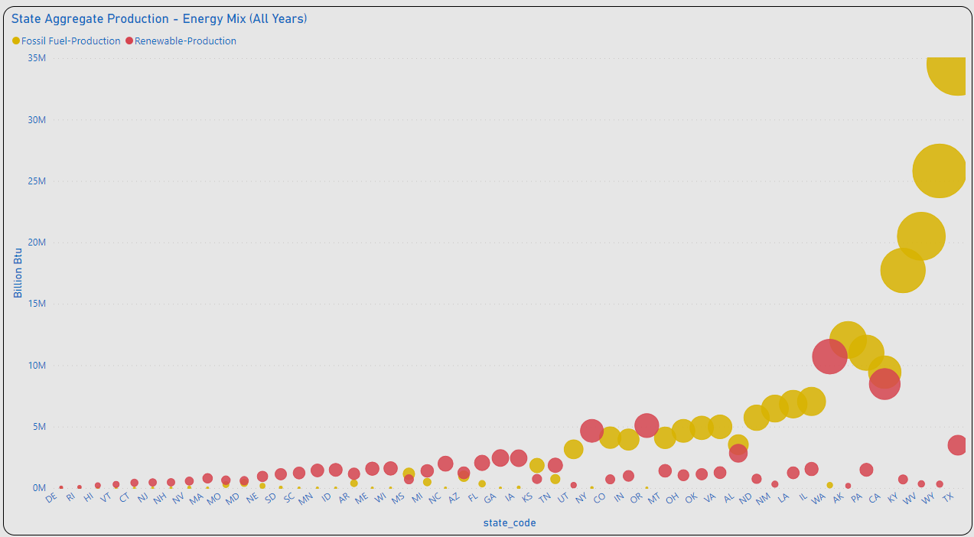
Energy Mix – Aggregate Production
XXXX
XXXX
XXXXXXXXXX

Slide 34
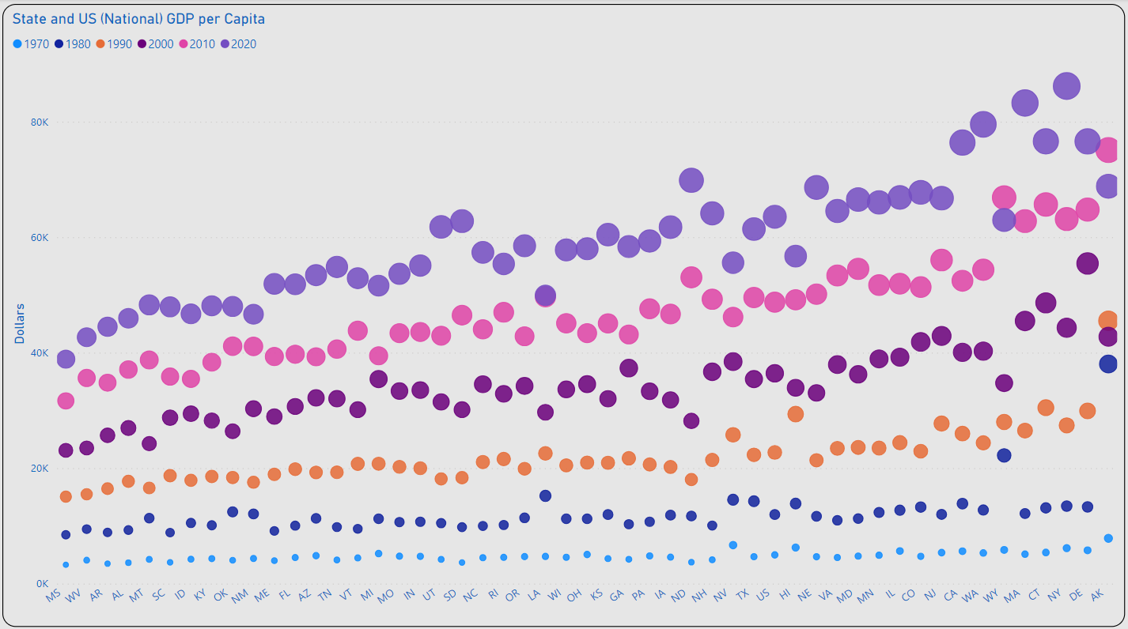
GDP per Capita Growth
XXXX
XXXX
????????????

Slide 35
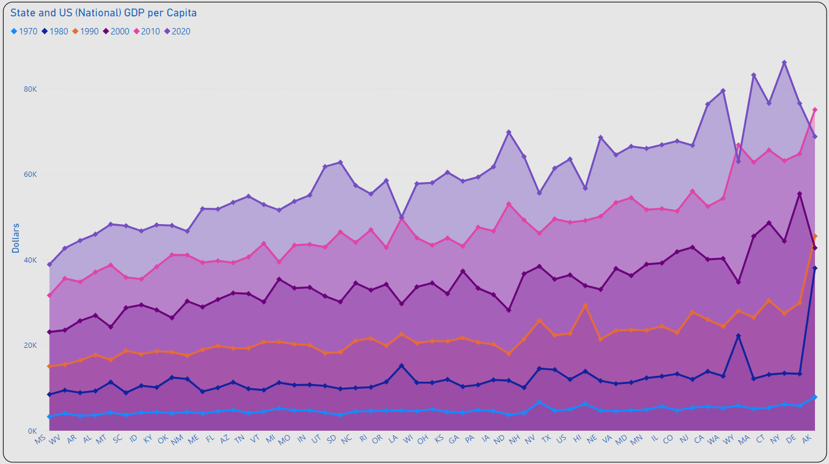
GDP per Capita Change
XXXX
XXXX
????????????

Slide 36
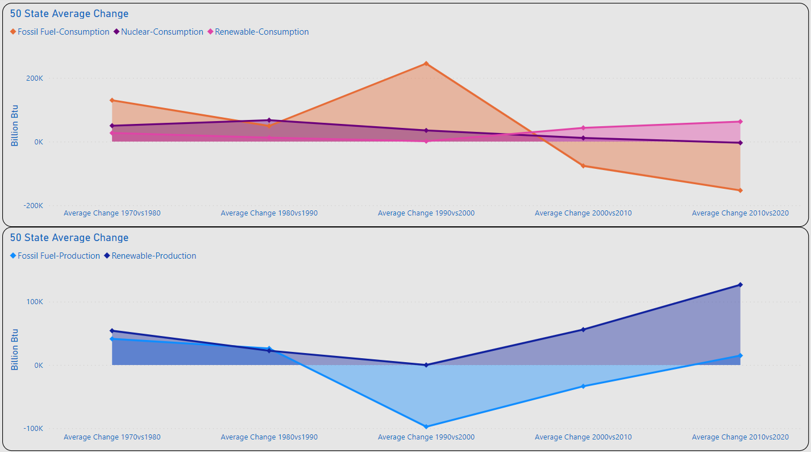
Amount of Change
FF: 245K
N: 67.3K
R: 62.8K
Significant Changes Consumption
1980vs1990: Nuclear: 67.3 (BN Btu)
1990vs2000: Fossil Fuel 245K (BN Btu)
2010vs2020: Renewables 62.8K
FF: 245K
BAD CHART
FF: -153.2K
FF: 245K
FF: 245K

Slide 37
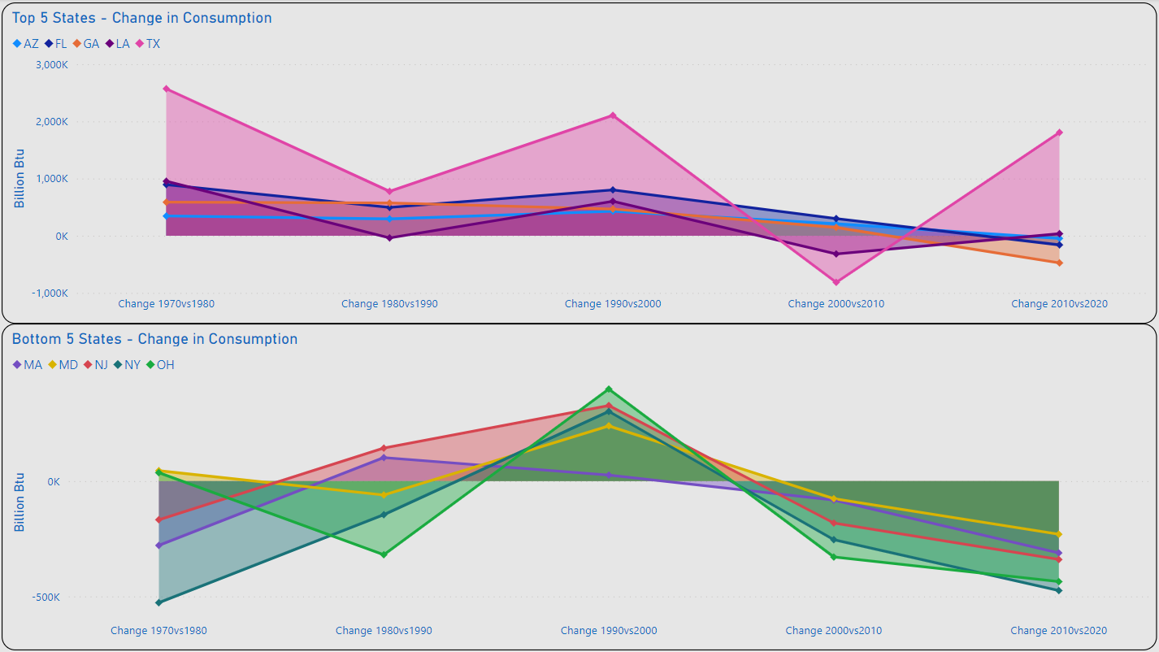
Top 5 / Bottom 5 - Overall
XXXX
XXXX
BAD CHART

Slide 38
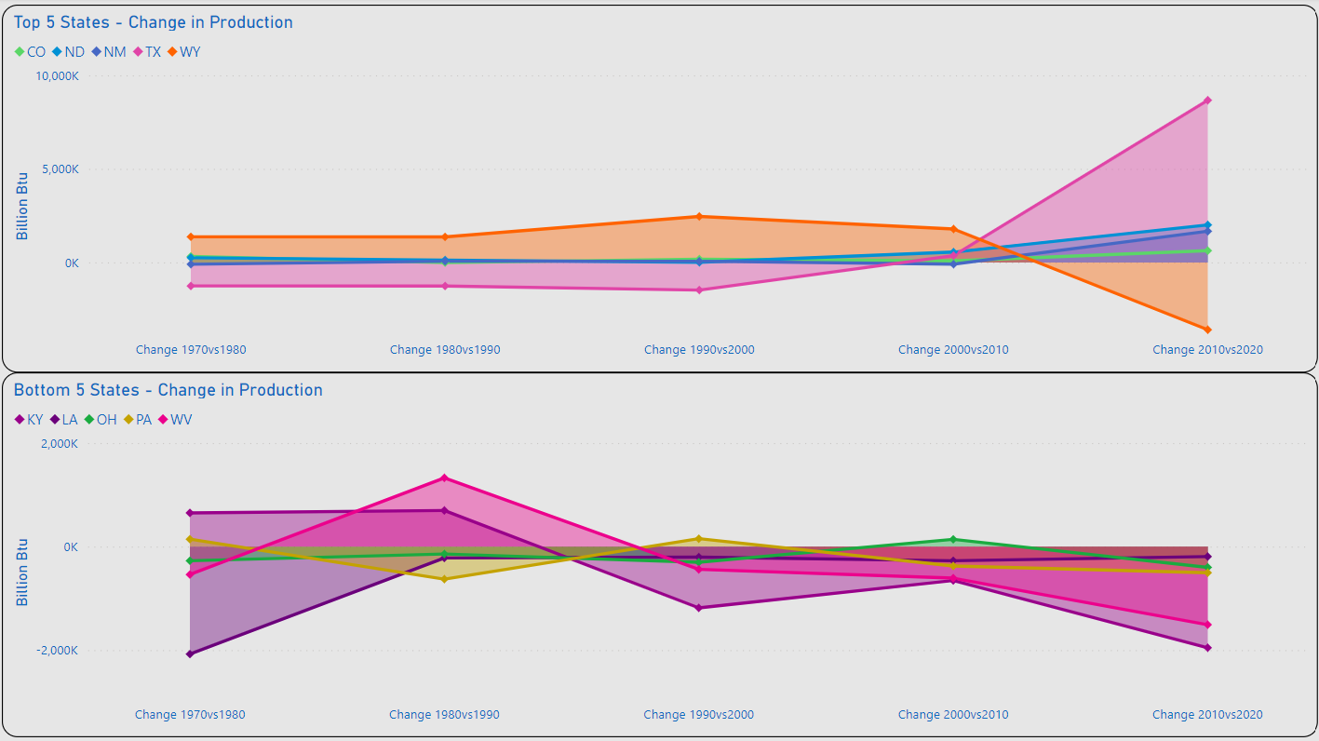
Top 5 / Bottom 5 - Overall
XXXX
XXXX
BAD CHART

Slide 39
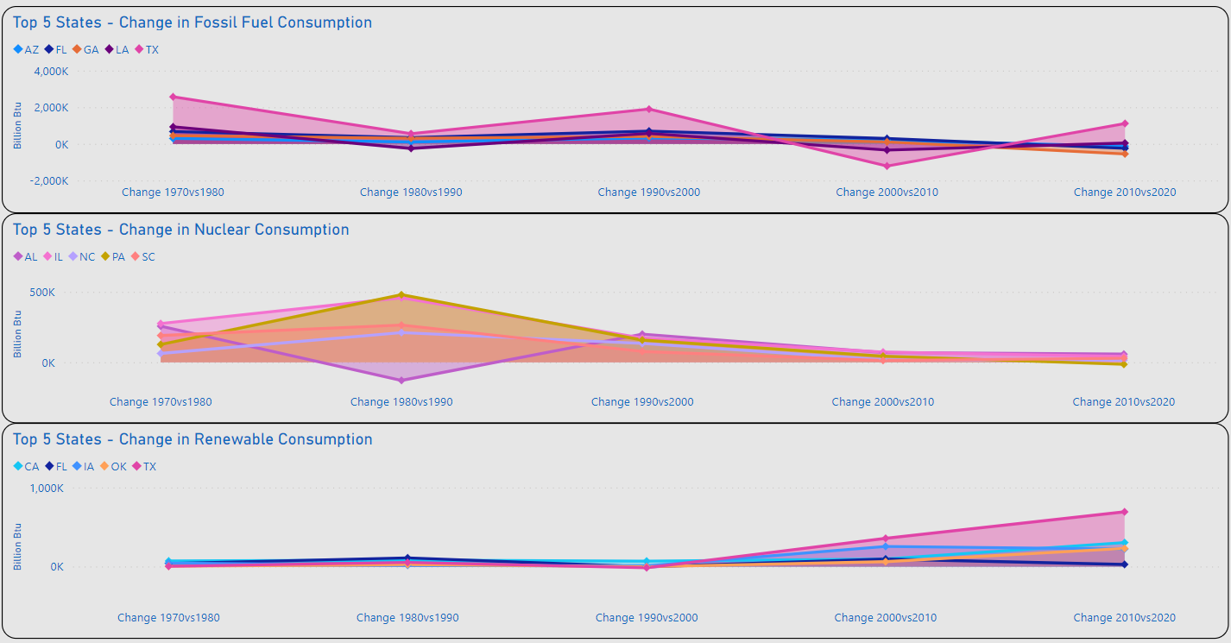
Top 5 / Bottom 5 – Energy Mix
XXXX
XXXX
BAD CHART

Slide 40
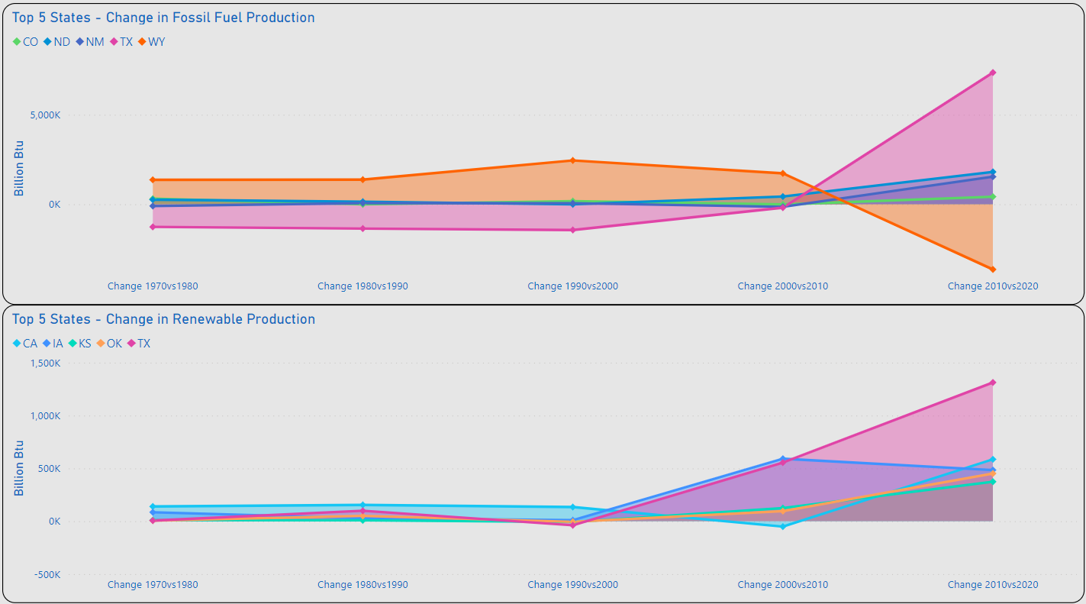
Top 5 / Bottom 5 – Energy Mix
XXXX
XXXX
BAD CHART

Slide 41
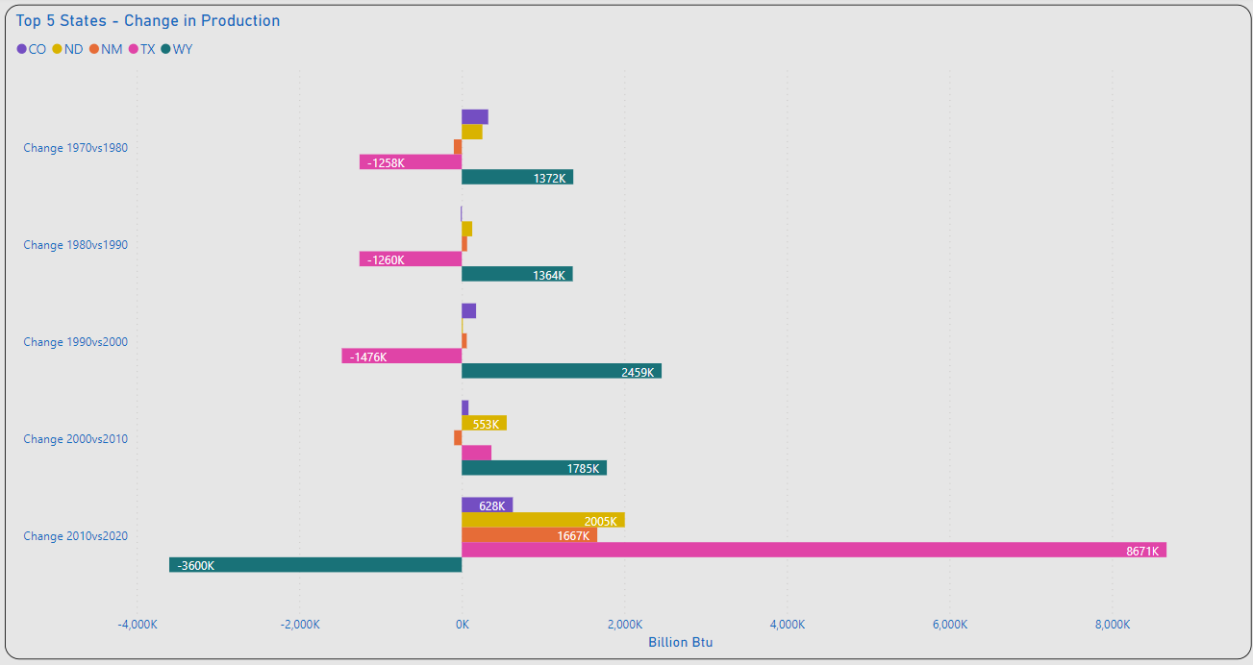
Top 5 - States
XXXX
XXXX

Slide 42
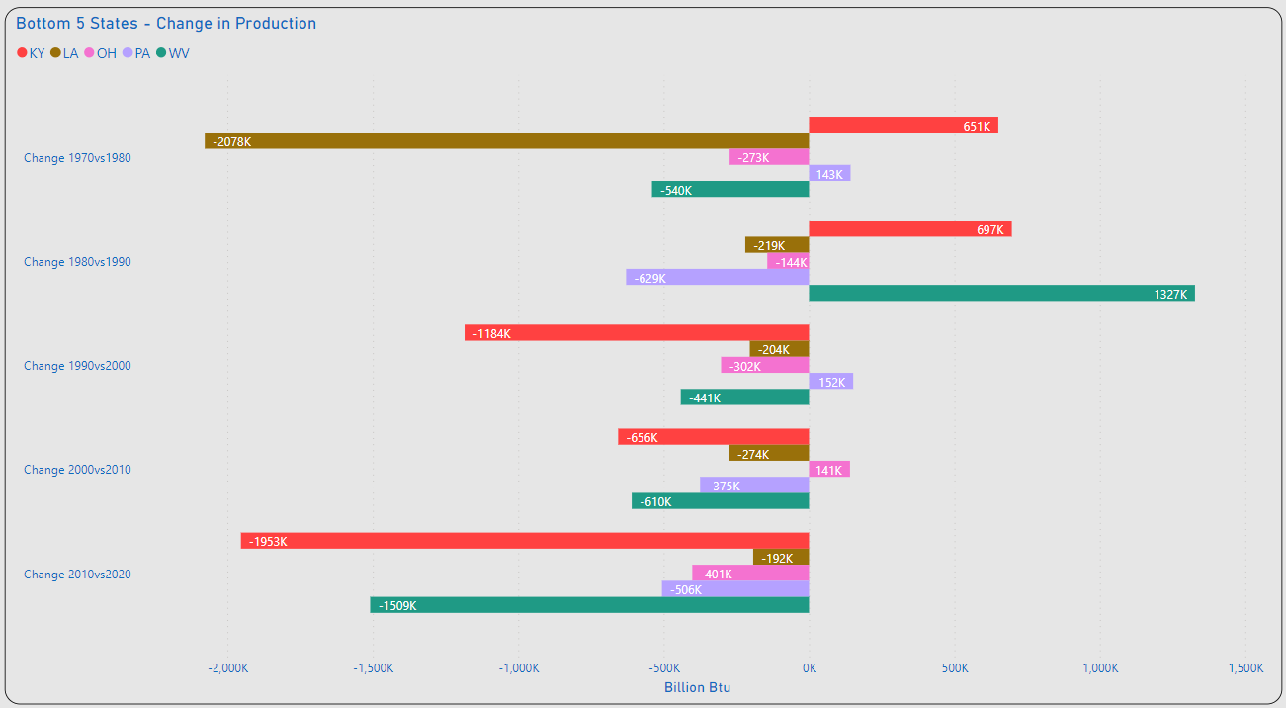
Bottom 5 - States
XXXX
XXXX

Slide 43
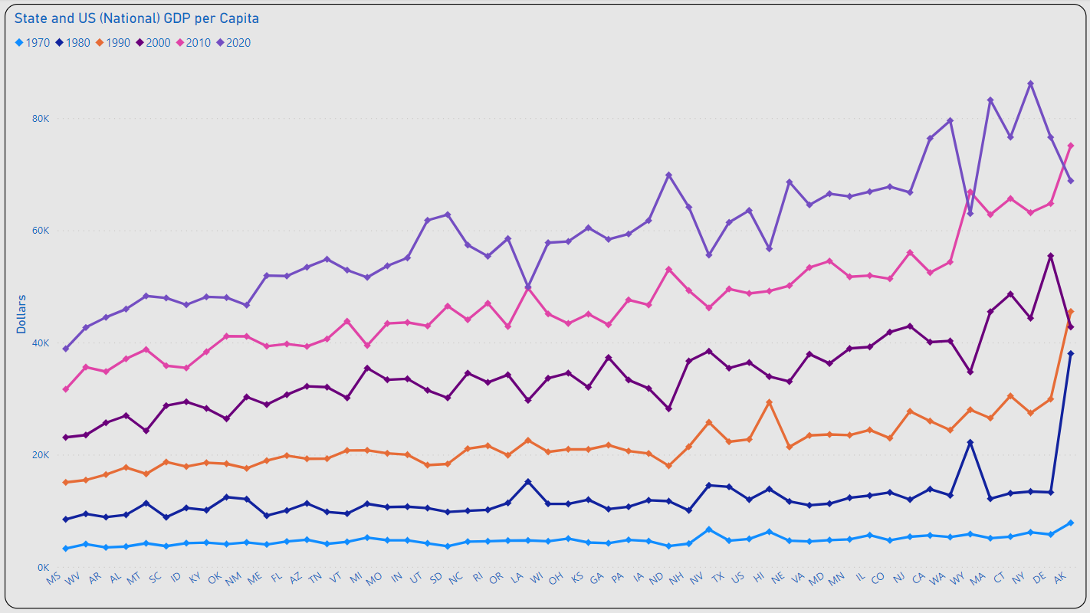
GDP per Capita Change
XXXX
XXXX
????????????

Slide 44
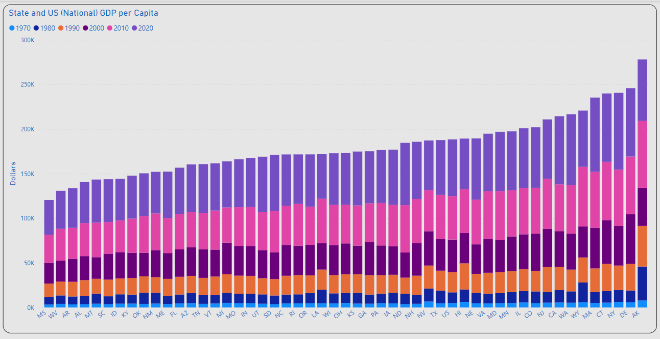
XXXX
XXXX
XXXX
????????????

Slide 45
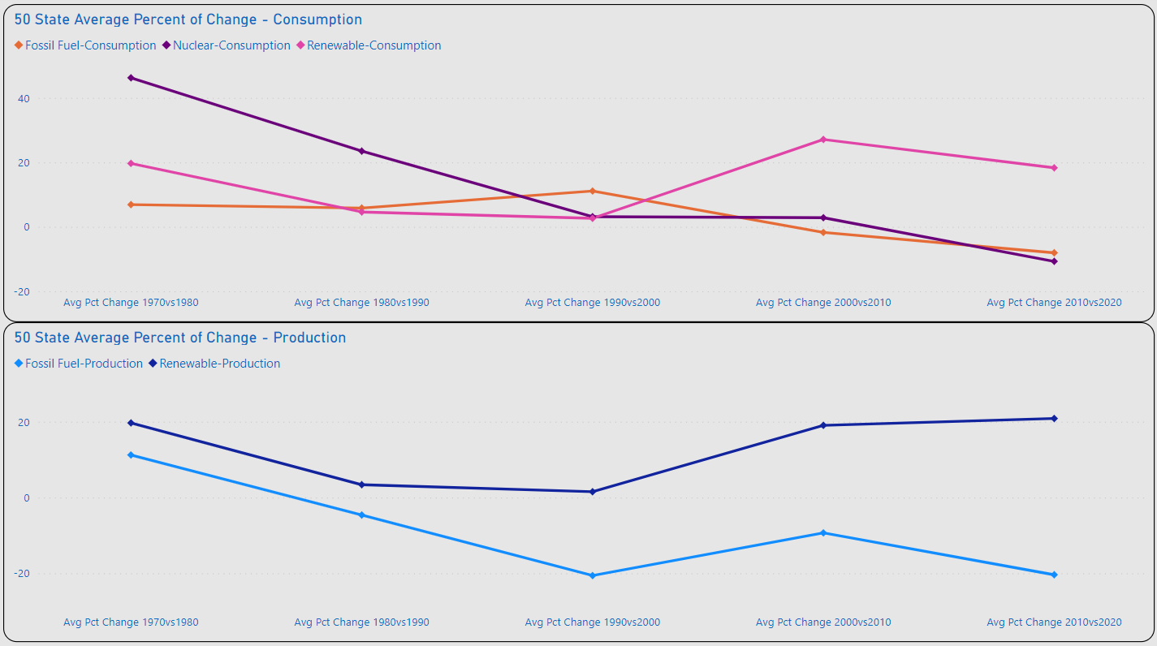
Percent of Change
XXXX
XXXX

Slide 46
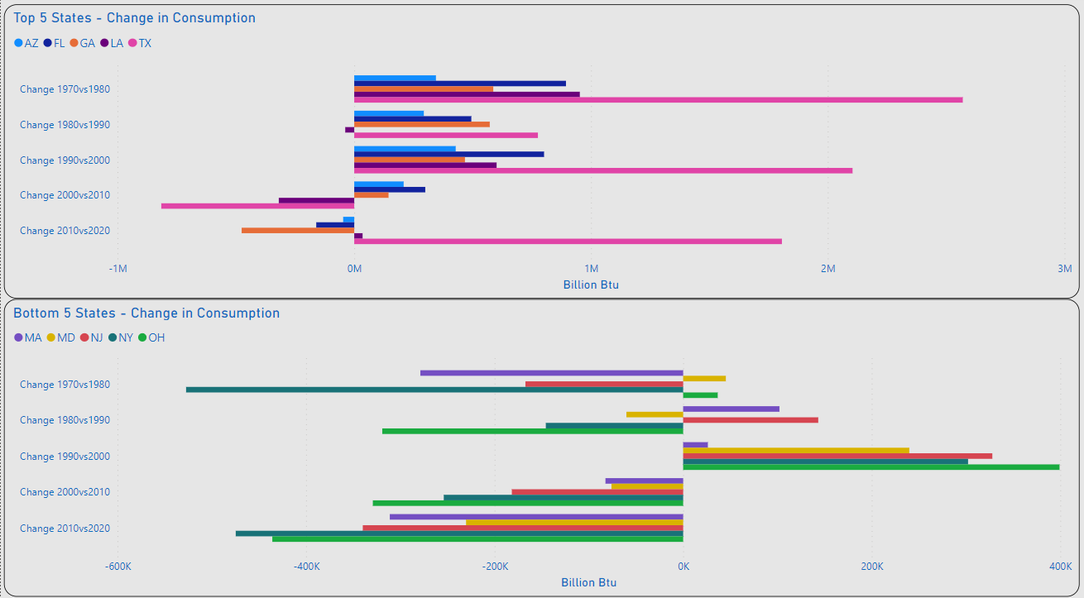
Top 5 / Bottom 5 – Change Consumption
Most of the Top 5 Changes were Increases < 1M (BN Btu)
TX & FL Made the Most Significant Increases in Overall Consumption
Most of the Bottom 5 Changes were Decreases < 350K (BN Btu)
NY & OH Made the Most Significant Decreases in Overall Consumption

Slide 47
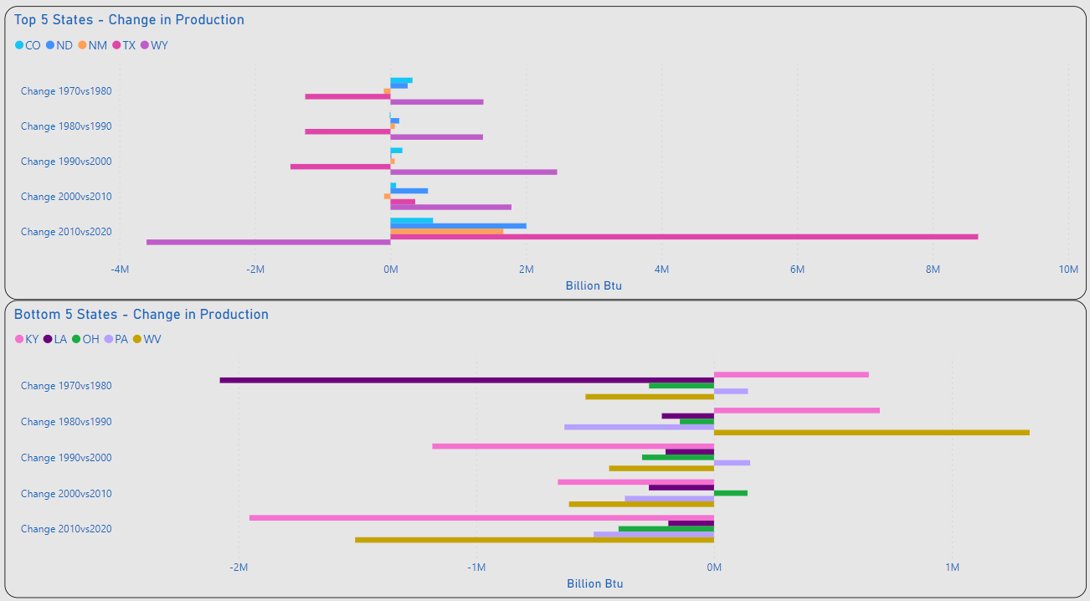
Top 5 / Bottom 5 – Change Production
Almost Equal Shifts in Production are Observed Between TX & WY for 1970 - 2000
TX Made the Most Significant Increase for 2010vs2020
Most of the Bottom 5 Changes were Decreases < 700K (BN Btu)
LA Made the Most Significant Decrease for All Years
KY & WV Made Almost Equal Increases & Decreases for Years Observed

Slide 48
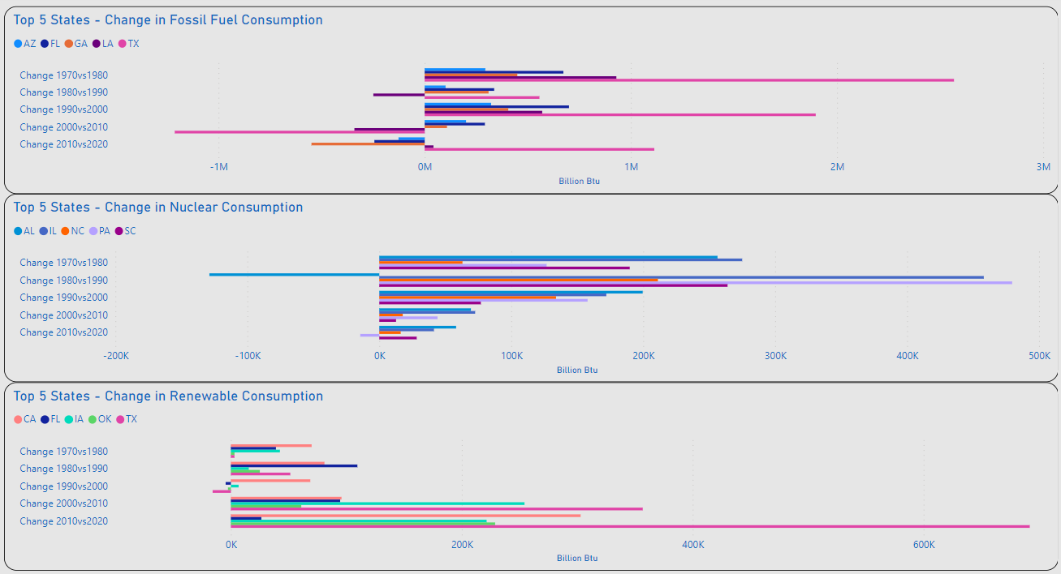
XXXX
TX Displays the Most Significant Increases in Fossil Fuel & Renewable Consumption for Years Observed
Fossil Fuel and Nuclear Displays Highest Volume of Increases 1970-2000
Renewable Consumption Displays Significant Increases After 2000

Slide 49
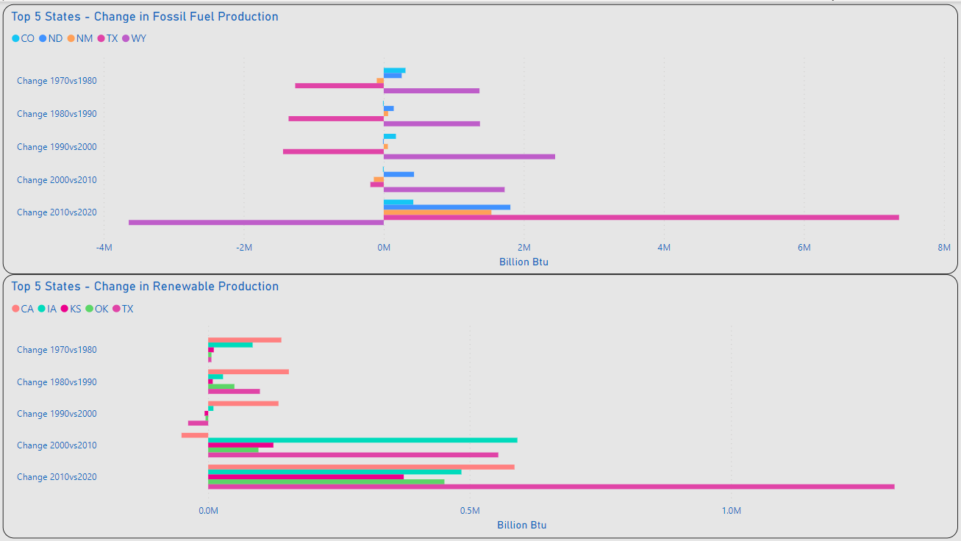
XXXX
Fossil Fuel Chart Closely Mirrors the Overall Production Chart
Renewable Production Displays Significant Increases After 2000

Slide 50
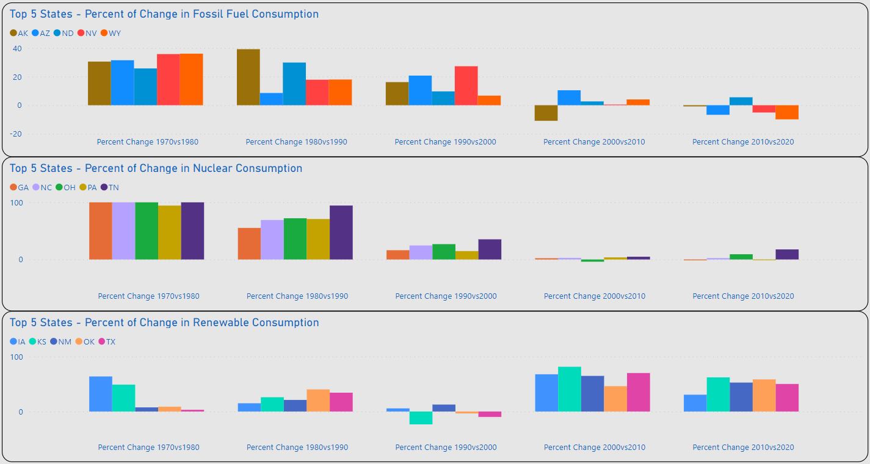
XXXX
REVIEW/REWRITE
TX Displays the Most Significant Increases in Fossil Fuel & Renewable Consumption for Years Observed
Fossil Fuel and Nuclear Displays Highest Volume of Increases 1970-2000
Renewable Consumption Displays Significant Increases After 2000

Slide 51
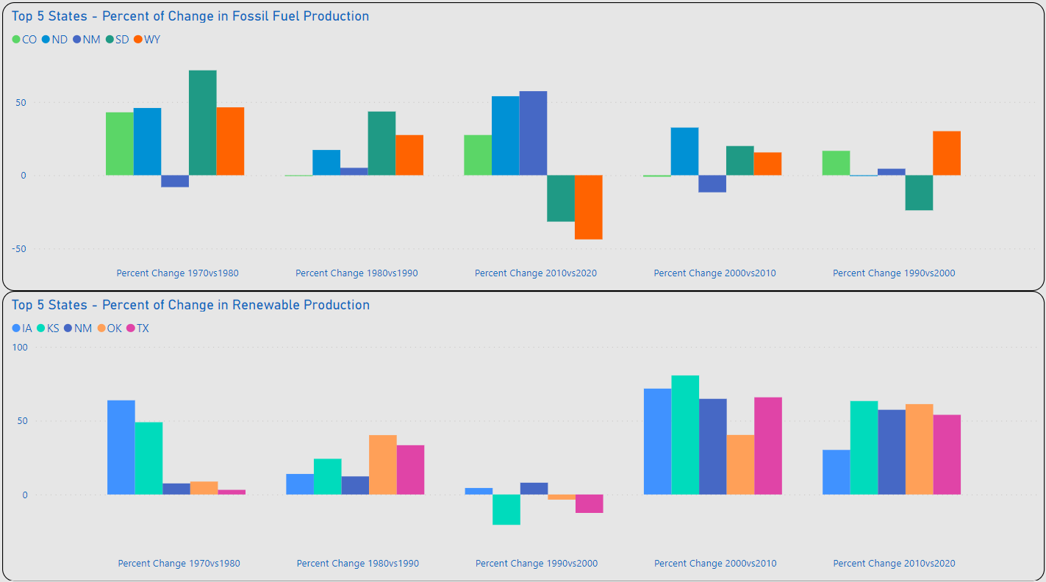
XXXX
REVIEW/REWRITE
Fossil Fuel Chart Closely Mirrors the Overall Production Chart
Renewable Production Displays Significant Increases After 2000

Slide 52
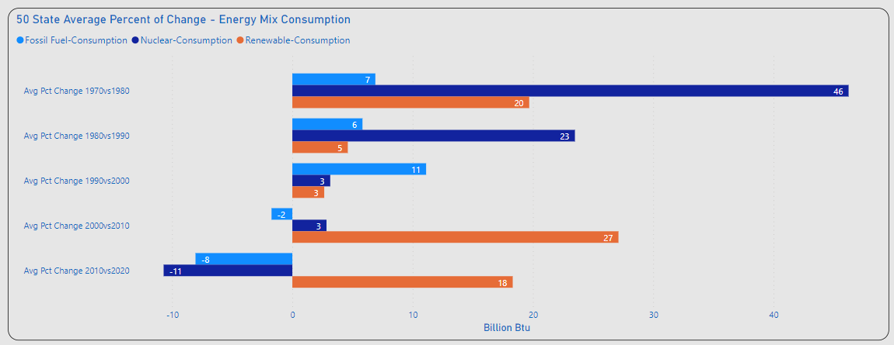
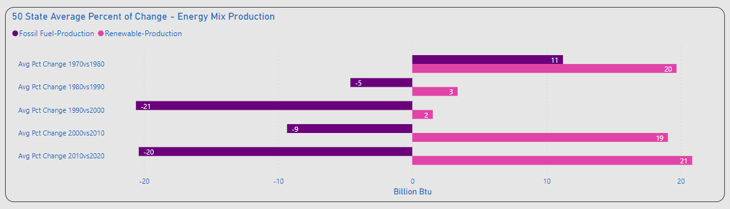
XXXX
Significant Percent of Change Consumption
1970vs1980: Nuclear(+)
2000vs2010: Renewables(+)
2010vs2020: Fossil Fuel / Nuclear (-), Renewables(+)
Significant Changes Production
Overall Fossil Fuel(-)
Overall Renewable(+)

Slide 53
XXXX
Significant Percent of Change Consumption
1970vs1980: Nuclear(+)
2000vs2010: Renewables(+)
2010vs2020: Fossil Fuel / Nuclear (-), Renewables(+)
Significant Changes Production
Overall Fossil Fuel(-)
Overall Renewable(+)

Slide 54
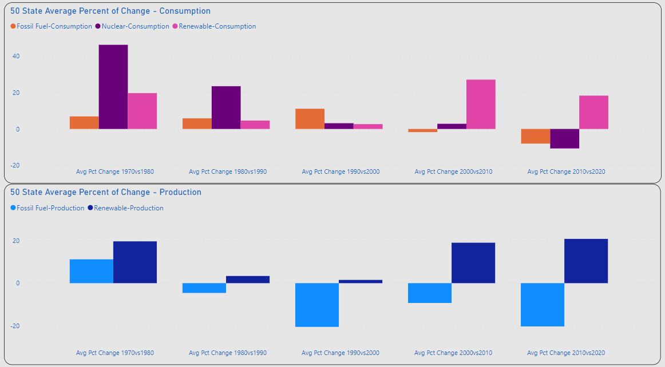
Percent of Change
XXXX
XXXX
XXXX

Slide 55
Occam’s Razor

Slide 56

Occam’s Razor
XXXX
XXXX

Slide 57
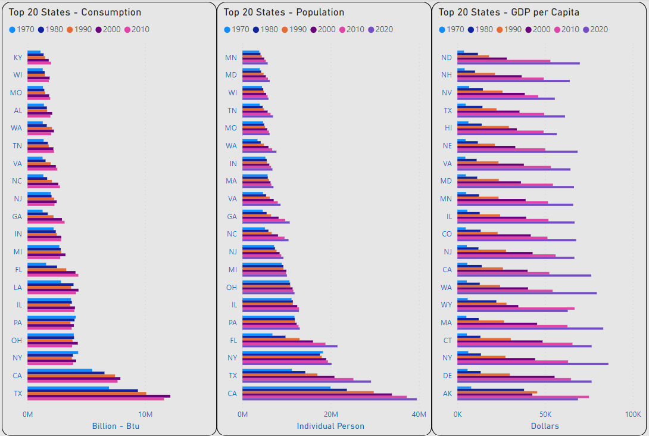
Occam’s Razor
Quick Review
Top 20 Consumption to Population: 17 of 20 States Match (85%)
Top 20 Consumption to GDP per Capita: 7 of 20 States Match (35%)

Slide 58
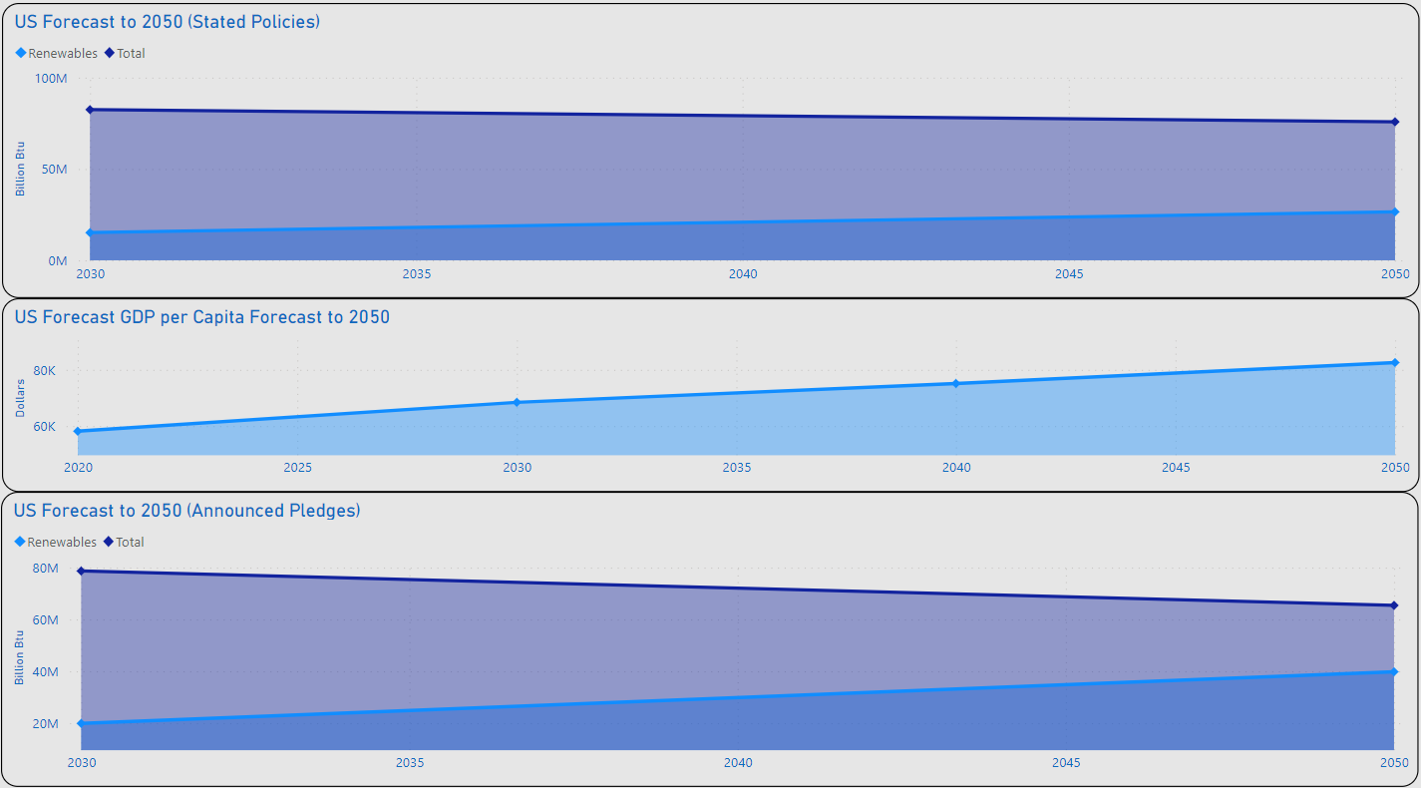
XXXX
XXXX
XXXX
CHOOSE 1 FORECECAST SLIDE

Slide 60
Title

Slide 61
Timeline
Deploy strategic networks with compelling e-business needs
Sep 20XX
Synergize scalable e-commerce
Nov 20XX
Disseminate standardized metrics
Jan 20XX
Coordinate e-business applications
March 20XX
Foster holistically superior methodologies
May 20XX

Slide 62
Primary goals
Annual revenue growth

